Slide 1
WIC2002 Network Security Individual Assignment DHCP Starvation
Muhammad Azri bin Zainuddin WER150018

Slide 2
DHCP
Dynamic Host Configuration Protocol - a protocol that automatically provides an Internet Protocol (IP) host with its IP address and other related configuration information such as the subnet mask and default gateway.
Operates on Layer 7 (Application) on OSI model
A router or a residential gateway can be enabled to act as a DHCP server.
UDP no. 67 –port of a server, and UDP no. 68 – port by the client

Slide 3
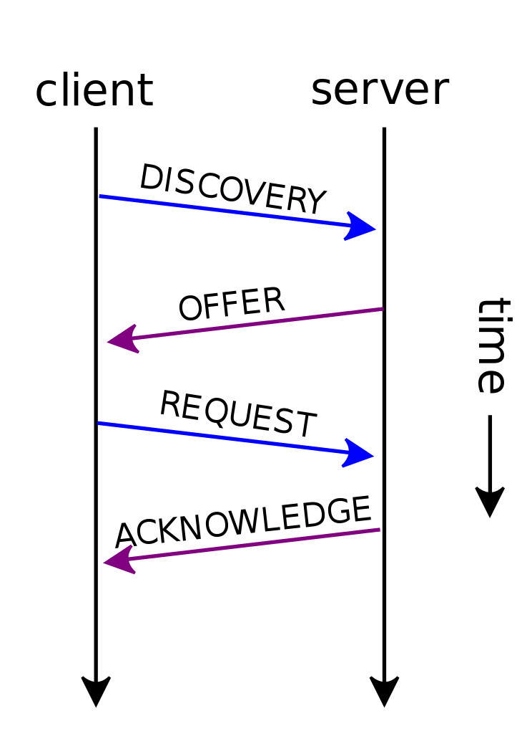
How it works

Slide 4
DHCP DISCOVERY
Client broadcasts message using
255.255.255.255 as destination address
Specific subnet broadcast address
Request its last-known IP address

Slide 5
DHCP OFFER
DHCP server receives a DHCPDISCOVER message
Server reserves an IP address for the client, and make a lease offer (DHCPOFFER) – contains the client’s:
MAC address
IP address that is being offered
Subnet mask
Lease duration
IP address of the DHCP server making the offer

Slide 6
DHCP REQUEST
When being offered, the client replies with a DHCP request, broadcast to the server, requesting the offered address
A client can receive DHCP offers from multiple servers, but it will accept only one DHCP offer
In this case, servers are informed whose offer the client has accepted (because it’s a broadcast)
Other DHCP servers will withdraw any offers that they have made, and return the offered address to the pool of available addresses

Slide 7
DHCP ACKNOWLEDGEMENT
When server receives the DHCPREQUEST message from the client, it sends back an acknowledgement, includes:
Lease duration
Any other configuration info the client might have requested
The client configures its network interface with the negotiated parameters

Slide 8
DHCP Starvation – How does it work?
Keeps on sending DHCPREQUEST with spoofed (fake) MAC addresses which come from one source (the attacker)
DHCP server
Keeps on responding to these DHCP REQUEST messages
All available IP addresses will be depleted
Using resources to respond to the DHCP REQUEST messages

